Slide 1
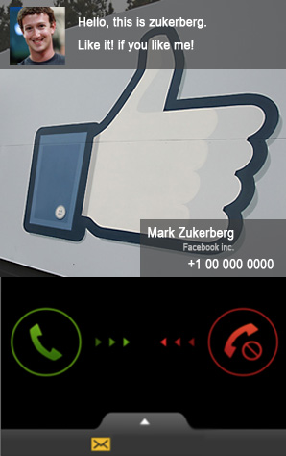
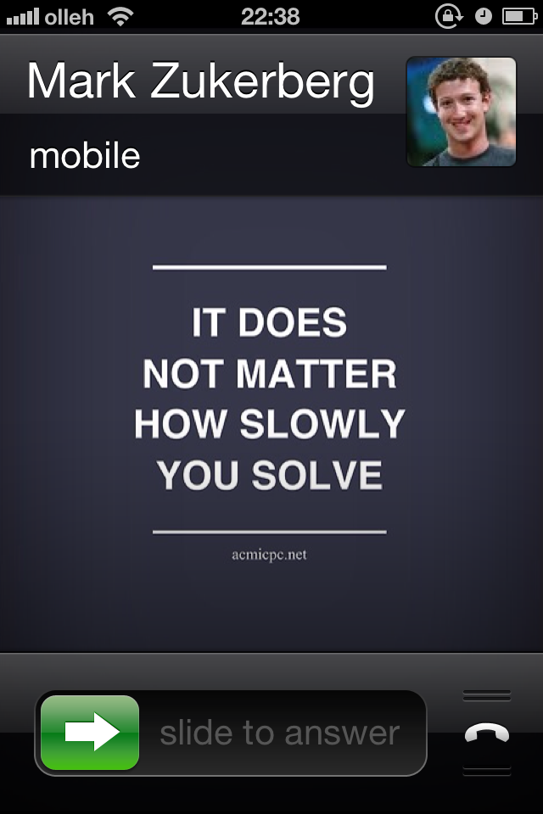
1. Incoming call (from Mark)
Android case
iPhone case

Slide 2
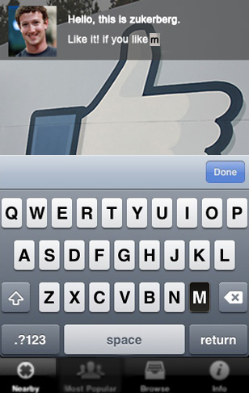
2. My view setting
Setting view

Slide 3
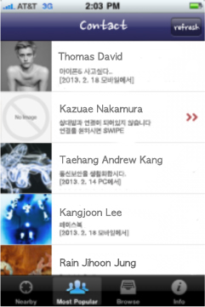

3. My Connected Friends list (1/2)
통화내역: CONTACT를
RECENT로 수정? –PRIORITY 수정
ABC
Friend who are not connected yet
My friends list

Slide 4
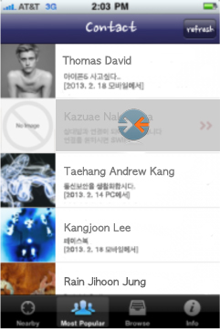
3. My Connected Friends list (2/2)
Tap to connect
swipe
Connect with my friend

Slide 5
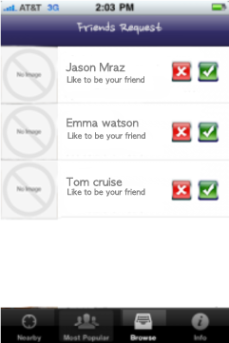
4. Friends Request
Show friends request

